Slide 1

Structured Query Language (sql) project 1
By Gokul

Slide 2
Introduction
Good Morning, everyone. My name is Gokul, and I'm here to present our Structured Query Language (sql) project.
It's aimed at simplifying the tasks of tracking, storing, and retrieving data related to students, courses, and their academic performance.
In today's presentation, we will provide an overview of the project's goals, the structure of our database, how we insert, retrieve, modify, and delete data, along with some example queries, triggers, and stored procedures we've implemented.
Our Student Management System project not only showcases our skills in database management but also addresses real-world challenges in academic institutions when it comes to managing student records efficiently.
Without further ado, let's dive into the details of our project and see how it can revolutionize student information management.

Slide 3
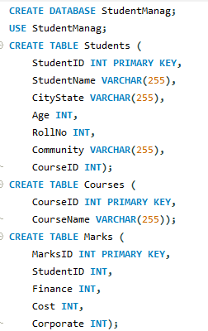
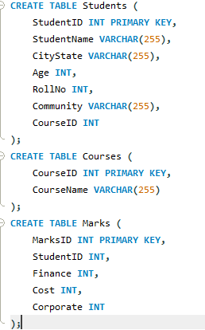
Main Commands Create database & Create Tables
Students Table: Contains information about students, including their unique StudentID, Name, City/State, Age, Roll No, Community, and the Course they are enrolled in (CourseID).
Courses Table: Stores information about courses offered. It has a unique CourseID and the CourseName.
Marks Table: Holds data related to the academic performance of students. Each record includes a unique MarksID, StudentID (to link to the corresponding student), and three columns for finance, cost, and corporate scores.
Foreign keys, such as CourseID in the Students table, establish relationships between tables. In this schema, the CourseID in the Students table references the CourseID in the Courses table, creating a relationship between students and the courses they are enrolled in.

Slide 4
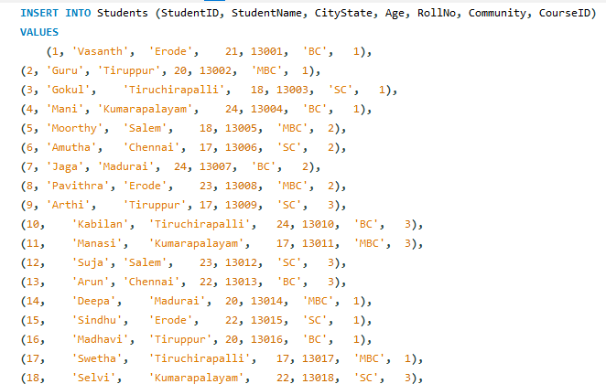
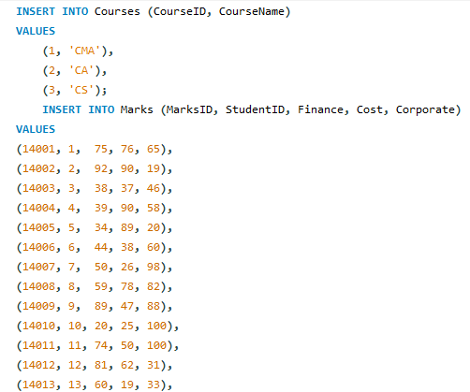
Data Insertion Insert Values

Slide 5
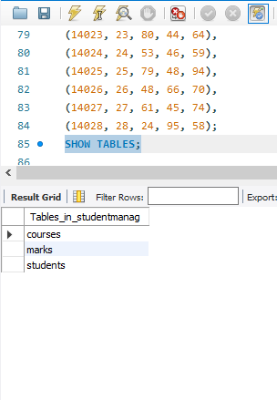
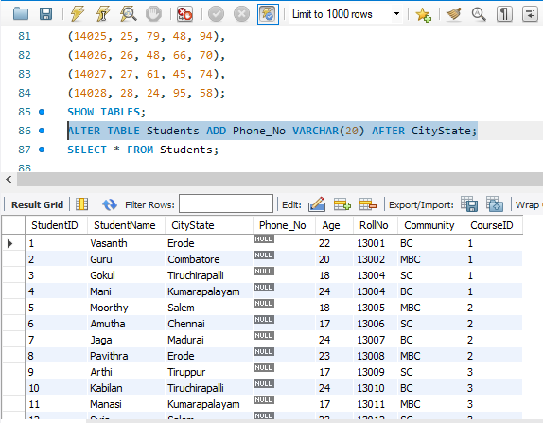
Show tables & Alter table ( For New Column Creation)
SHOW TABLES
ALTER TABLE Students ADD Phone_No VARCHAR(20) AFTER CityState

Slide 6
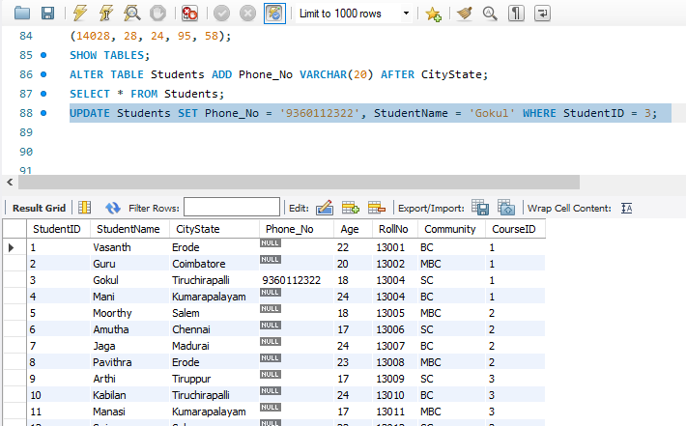
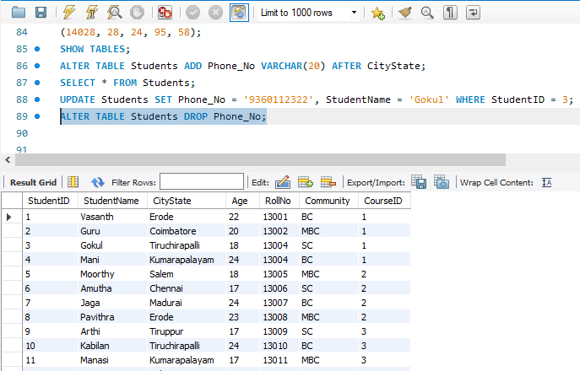
Update Table ( To change the Values) & Alter Table Drop ( Drop the Column)
UPDATE Students SET Phone_No = '9360112322', StudentName = 'Gokul' WHERE StudentID = 3
ALTER TABLE Students DROP Phone_No

Slide 7
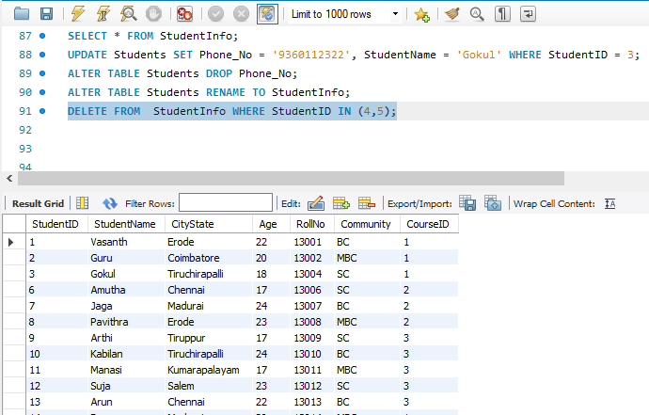
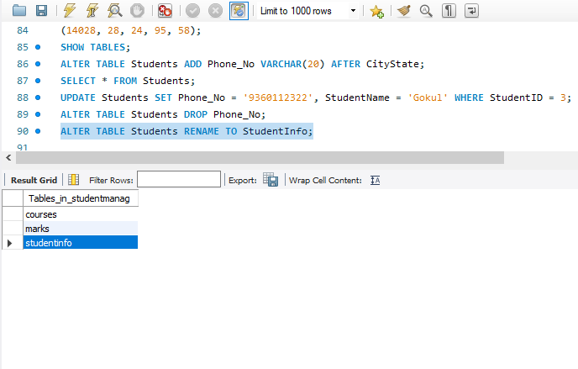
Rename (Rename the Table) & Delete Statement
ALTER TABLE Students RENAME TO StudentInfo
DELETE FROM StudentInfo WHERE StudentID IN (4,5)

Slide 8
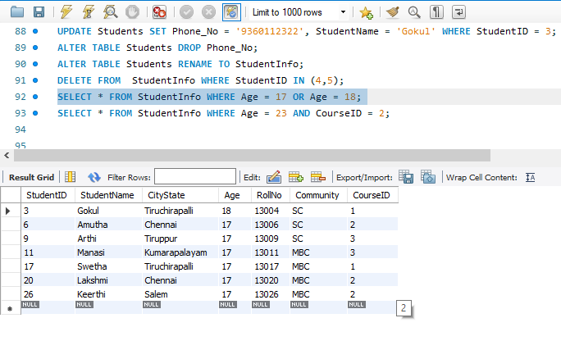
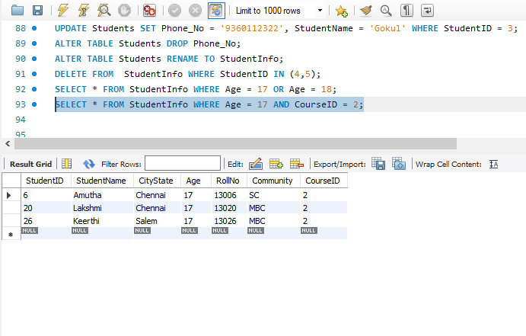
General Functions Where OR & Where AND
SELECT * FROM StudentInfo WHERE Age = 17 OR Age = 18
SELECT * FROM StudentInfo WHERE Age = 17 AND CourseID = 2

Slide 9
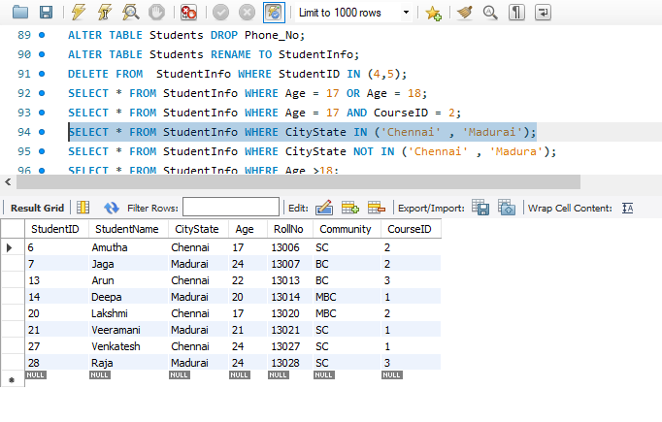
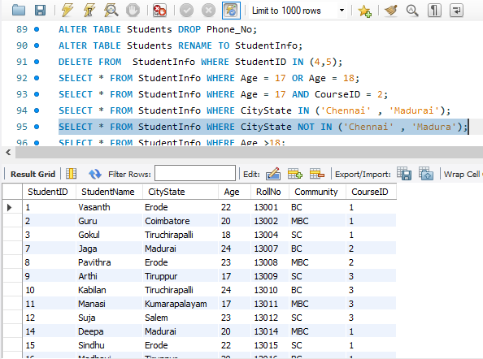
IN & NOT IN
SELECT * FROM StudentInfo WHERE CityState IN ('Chennai' , 'Madurai')
SELECT * FROM StudentInfo WHERE CityState NOT IN ('Chennai' , 'Madura')

Slide 10
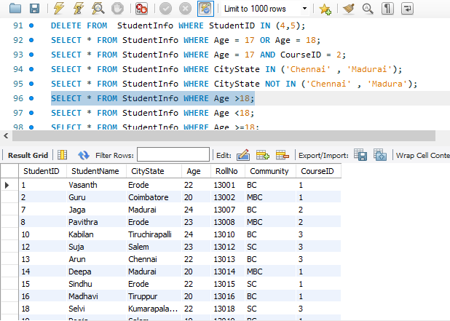
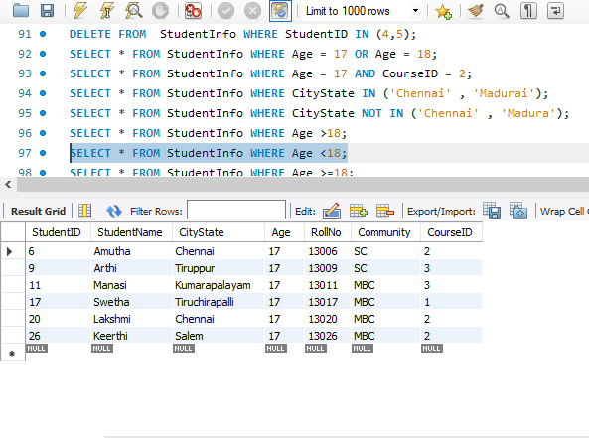
Greater than (>) & Less than (<)
SELECT * FROM StudentInfo WHERE Age >18
SELECT * FROM StudentInfo WHERE Age <18

Slide 11
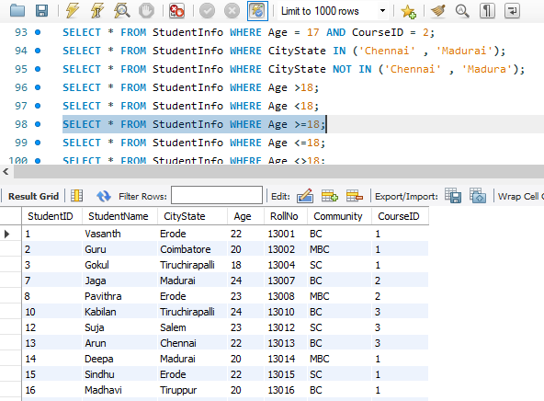
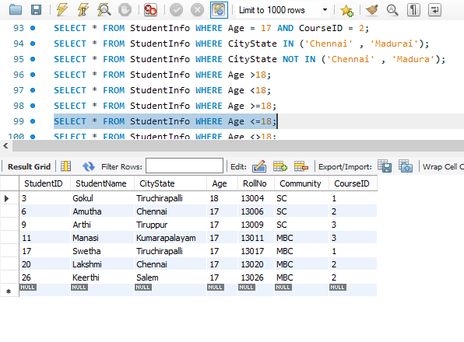
Greater than or EqualTo (>=) & Less than or EqualTo (>=)
SELECT * FROM StudentInfo WHERE Age >=18
SELECT * FROM StudentInfo WHERE Age <=18

Slide 12
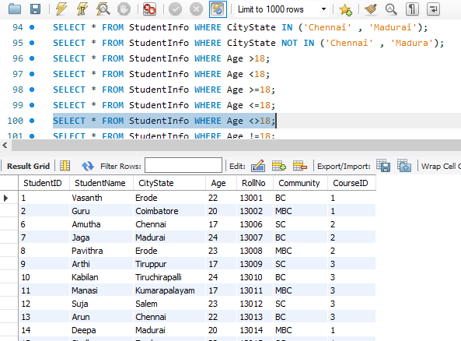
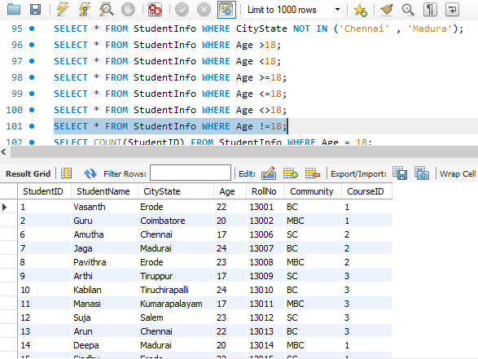
NOT IN (< >) & NOT Equal To (!=)
SELECT * FROM StudentInfo WHERE Age <>18
SELECT * FROM StudentInfo WHERE Age !=18

Slide 13
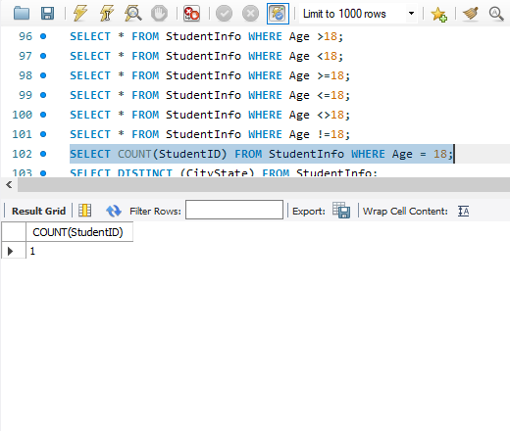
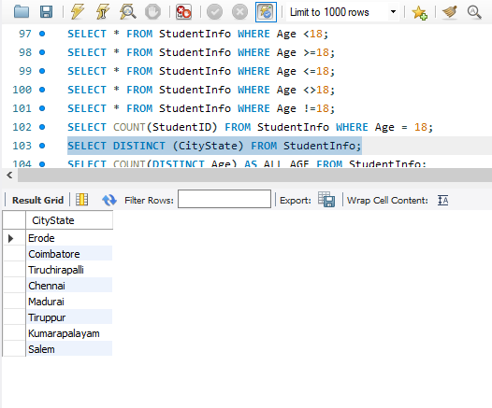
Count & Distinct
SELECT COUNT(StudentID) FROM StudentInfo WHERE Age = 18
SELECT DISTINCT (CityState) FROM StudentInfo

Slide 14
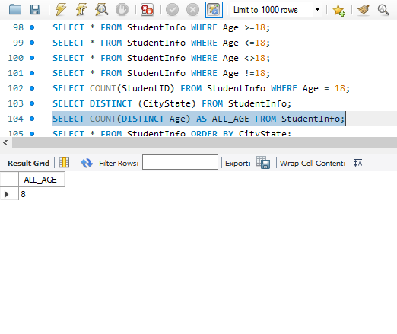
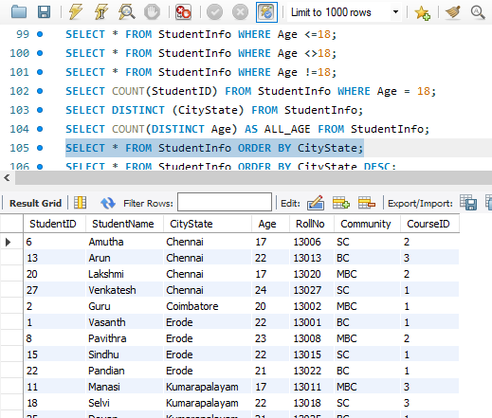
Count with Distinct & Order By
SELECT COUNT(DISTINCT Age) AS ALL_AGE FROM StudentInfo
SELECT * FROM StudentInfo ORDER BY CityState

Slide 15
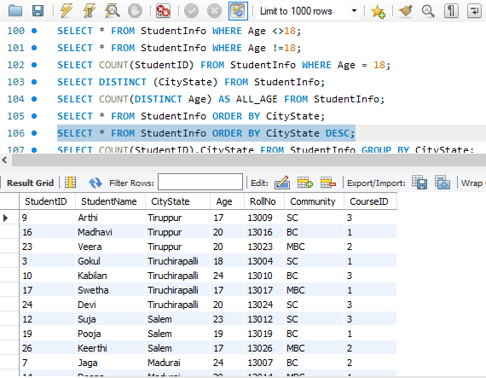
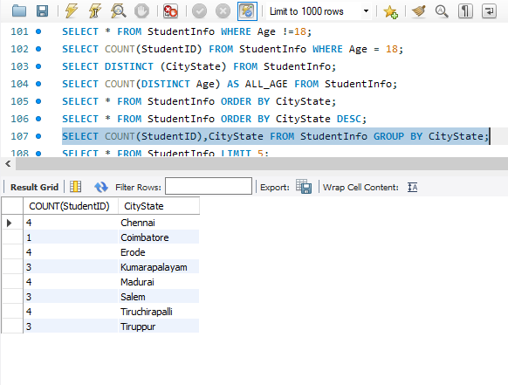
Order By Descending & Group By
SELECT * FROM StudentInfo ORDER BY CityState DESC
SELECT COUNT(StudentID),CityState FROM StudentInfo GROUP BY CityState

Slide 16
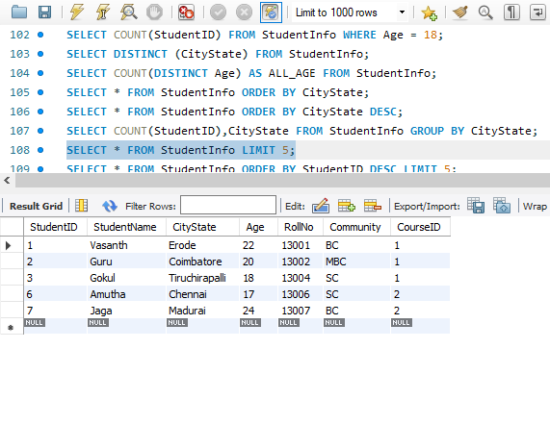
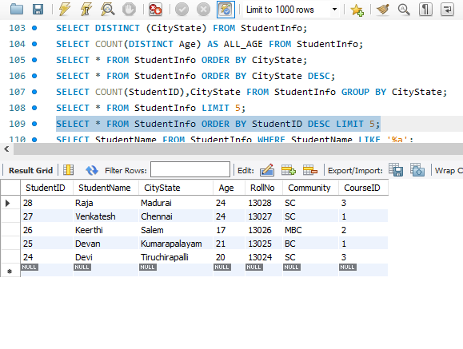
Limit & Limit Descending
SELECT * FROM StudentInfo LIMIT 5
SELECT * FROM StudentInfo ORDER BY StudentID DESC LIMIT 5

Slide 17
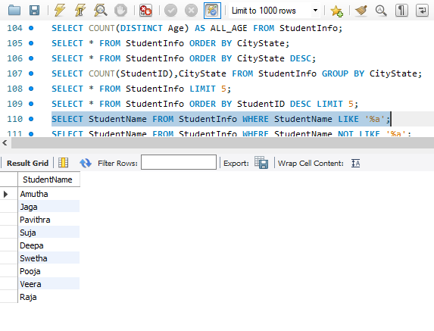
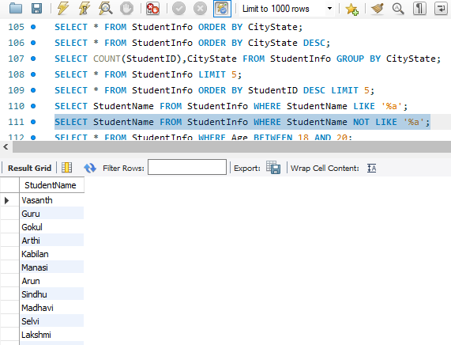
Like & Not Like
SELECT StudentName FROM StudentInfo WHERE StudentName LIKE '%a'
SELECT StudentName FROM StudentInfo WHERE StudentName NOT LIKE '%a'

Slide 18
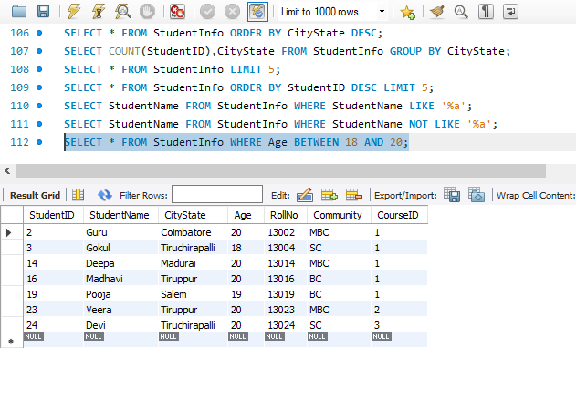
Between
SELECT * FROM StudentInfo WHERE Age BETWEEN 18 AND 20

Slide 19
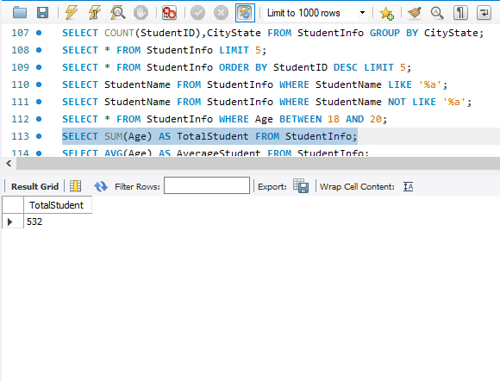
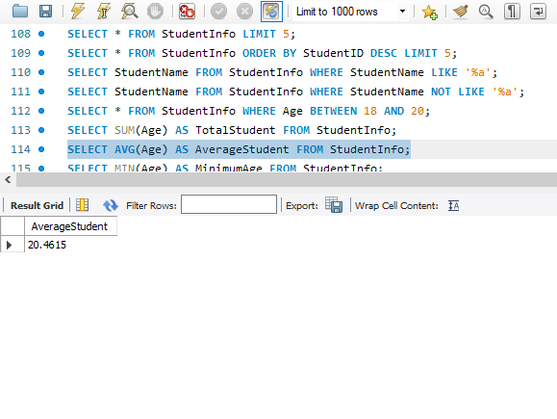
Calculate Functions Sum & Average
SELECT SUM(Age) AS TotalStudent FROM StudentInfo
SELECT AVG(Age) AS AverageStudent FROM StudentInfo

Slide 20
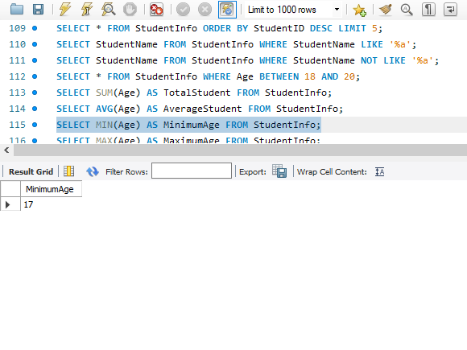
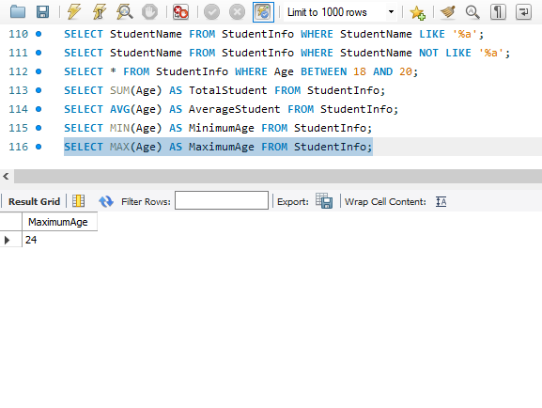
Minimum & Maximum
SELECT MIN(Age) AS MinimumAge FROM StudentInfo
SELECT MAX(Age) AS MaximumAge FROM StudentInfo

Slide 21
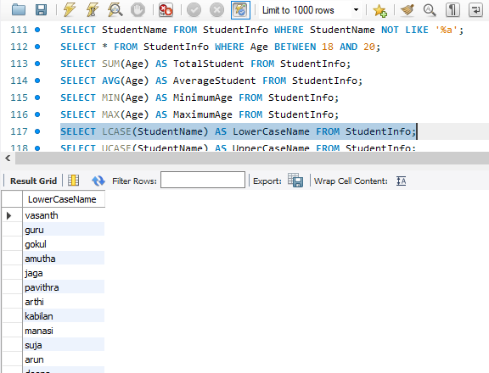
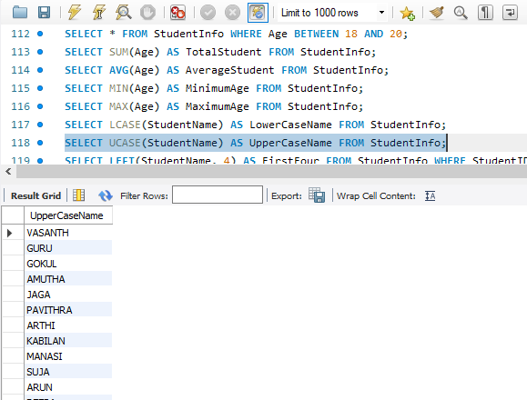
String Functions Lower case & Upper case
SELECT LCASE(StudentName) AS LowerCaseName FROM StudentInfo
SELECT UCASE(StudentName) AS UpperCaseName FROM StudentInfo

Slide 22
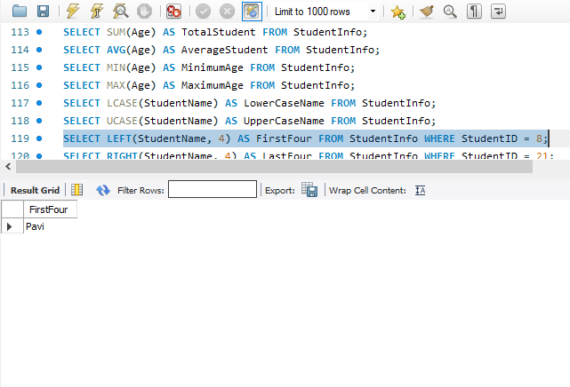
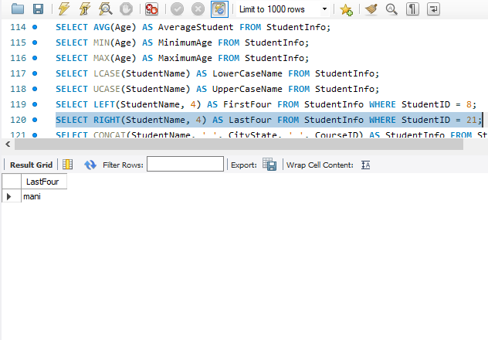
Left & Right
SELECT LEFT(StudentName, 4) AS FirstFour FROM StudentInfo WHERE StudentID = 8
SELECT RIGHT(StudentName, 4) AS LastFour FROM StudentInfo WHERE StudentID = 21

Slide 23
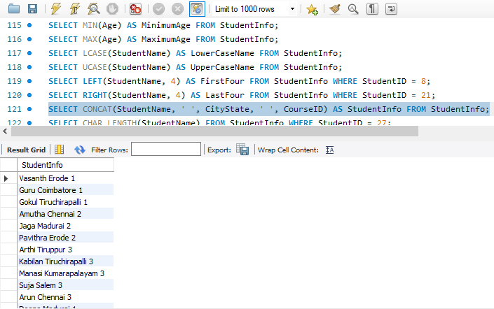
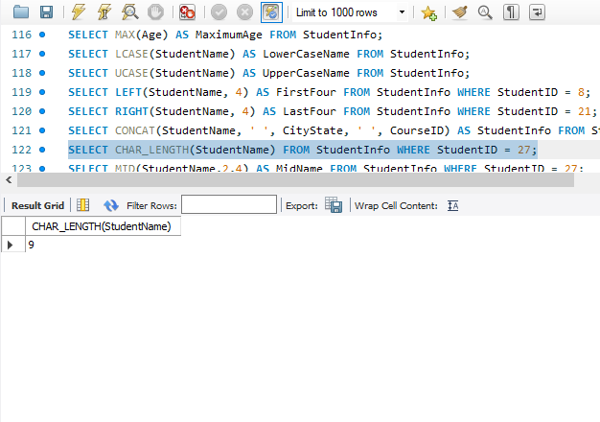
Concat & Char_Length
SELECT CONCAT(StudentName, ' ', CityState, ' ', CourseID) AS StudentInfo FROM StudentInfo
SELECT CHAR_LENGTH(StudentName) FROM StudentInfo WHERE StudentID = 27

Slide 24
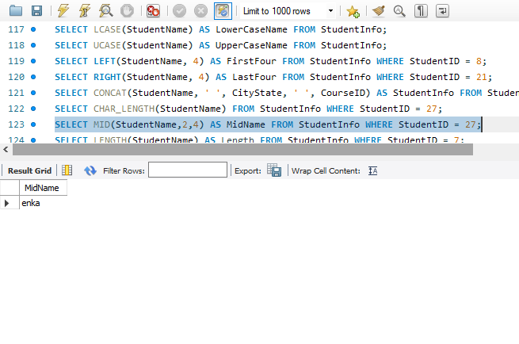
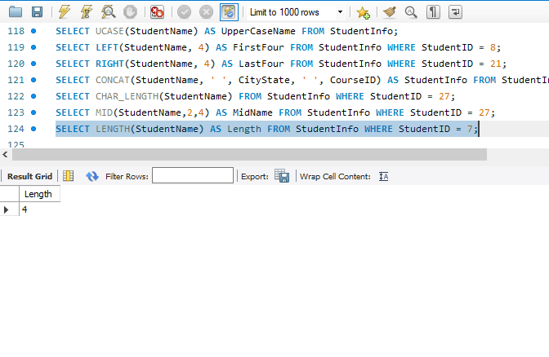
Mid & Length
SELECT MID(StudentName,2,4) AS MidName FROM StudentInfo WHERE StudentID = 27
SELECT LENGTH(StudentName) AS Length FROM StudentInfo WHERE StudentID = 7

Slide 25
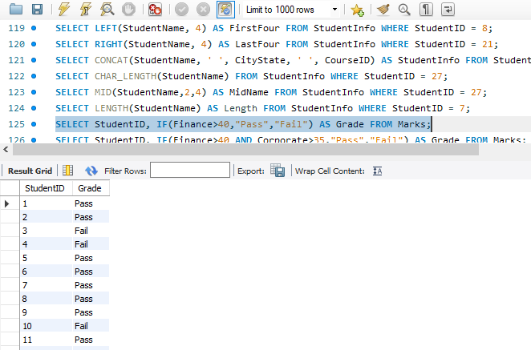
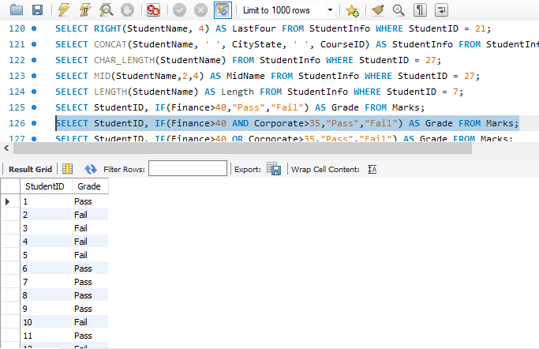
Logical Functions IF & IF with AND Condition
SELECT StudentID, IF(Finance>40,"Pass","Fail") AS Grade FROM Marks
SELECT StudentID, IF(Finance>40 AND Corporate>35,"Pass","Fail") AS Grade FROM Marks

Slide 26
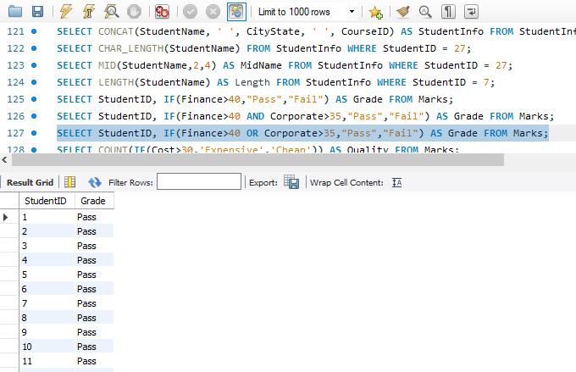
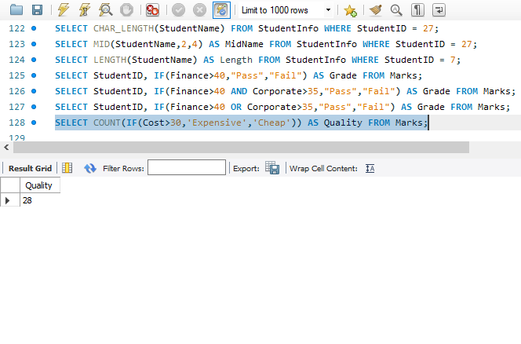
IF with OR Condition & Count IF
SELECT StudentID, IF(Finance>40 OR Corporate>35,"Pass","Fail") AS Grade FROM Marks
SELECT COUNT(IF(Cost>30,'Expensive','Cheap')) AS Quality FROM Marks

Slide 27
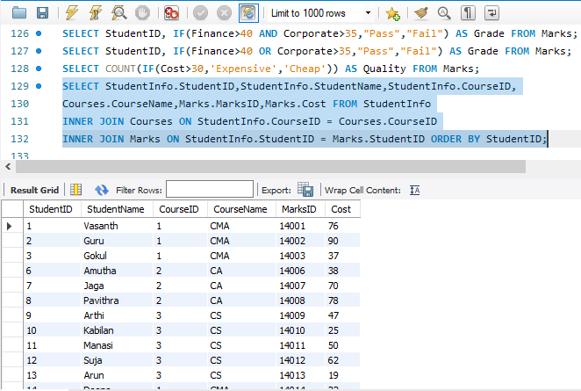
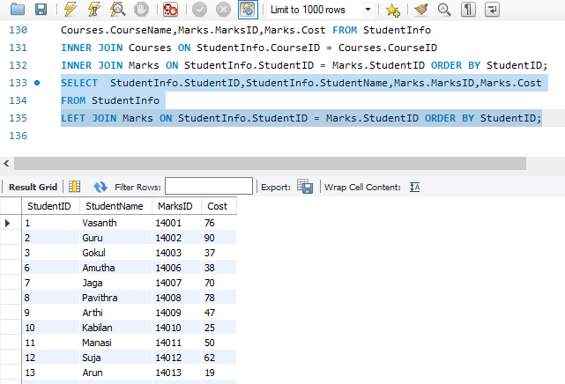
Join Functions Inner Join & Left Join
SELECT StudentInfo.StudentID,StudentInfo.StudentName,StudentInfo.CourseID,Courses.CourseName,Marks.MarksID,Marks.Cost FROM StudentInfoINNER JOIN Courses ON StudentInfo.CourseID = Courses.CourseIDINNER JOIN Marks ON StudentInfo.StudentID = Marks.StudentID ORDER BY StudentID
SELECT StudentInfo.StudentID,StudentInfo.StudentName,Marks.MarksID,Marks.CostFROM StudentInfoLEFT JOIN Marks ON StudentInfo.StudentID = Marks.StudentID ORDER BY StudentID

Slide 28
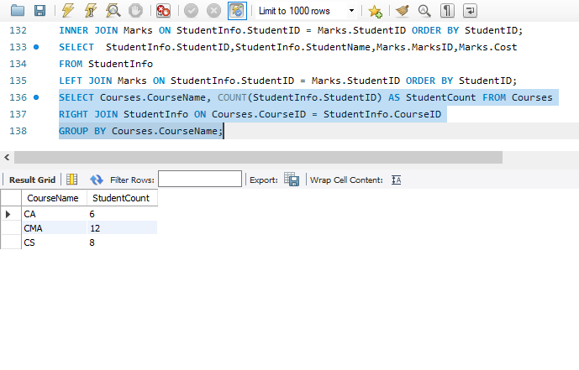

Right Join & Cross Join
SELECT Courses.CourseName, COUNT(StudentInfo.StudentID) AS StudentCount FROM CoursesRIGHT JOIN StudentInfo ON Courses.CourseID = StudentInfo.CourseIDGROUP BY Courses.CourseName
SELECT StudentInfo.StudentName, Courses.CourseName FROM StudentInfoCROSS JOIN Courses

Slide 29


Case and End Statement & Having Clause
SELECT StudentName, Age,CASE WHEN Age < 18 THEN 'Under 18' WHEN Age >= 18 AND Age <= 21 THEN '18-21' ELSE 'Over 21'END AS AgeCategoryFROM StudentInfo
SELECT Courses.CourseName, AVG(StudentInfo.Age) AS AvgAgeFROM StudentInfoJOIN Courses ON StudentInfo.CourseID = Courses.CourseIDGROUP BY Courses.CourseNameHAVING AVG(StudentInfo.Age) > 20

Slide 30


Procedures
delimiter //create procedure numbers()begindeclare Numb int;set numb = 90;select numb;end//delimiter ;call Numbers()
delimiter //create procedure city_count()begin declare count_city int;select Count(City_state)into Count_cityfrom Student_info;select count_city;end//delimiter ;call City_count()

Slide 31
Conclusion Key Takeaways
SQL Fundamentals: We've covered essential SQL commands, including SELECT, INSERT, UPDATE, DELETE, and more.
Data Manipulation: You've learned to retrieve, modify, and delete data from databases.
Database Objects: We discussed creating, altering, and dropping tables, indexes, and procedures.
Functions: SQL offers powerful functions for calculations, string operations, and logical conditions.
Joins: You're familiar with different types of joins to combine data from multiple tables.
Stored Procedures: We introduced the concept of stored procedures for encapsulating and reusing SQL logic

Slide 32
Project Highlights
Project Scope: We defined the project's objectives, data requirements, and goals.
Database Design: We created a relational database schema and defined tables, relationships, and constraints.
Data Management: We inserted sample data, performed data manipulations, and utilized SQL functions.
Triggers: We implemented triggers to automate updates and maintain data integrity.
Stored Procedures: We created and executed stored procedures for enhanced data processing.

Slide 33


